Slide 1
yop
A MATLAB Toolbox for Numerical Optimal Control based on CasADi
Viktor Leek PhD Student Linköping university Div. of Vehicular Systems

Slide 2
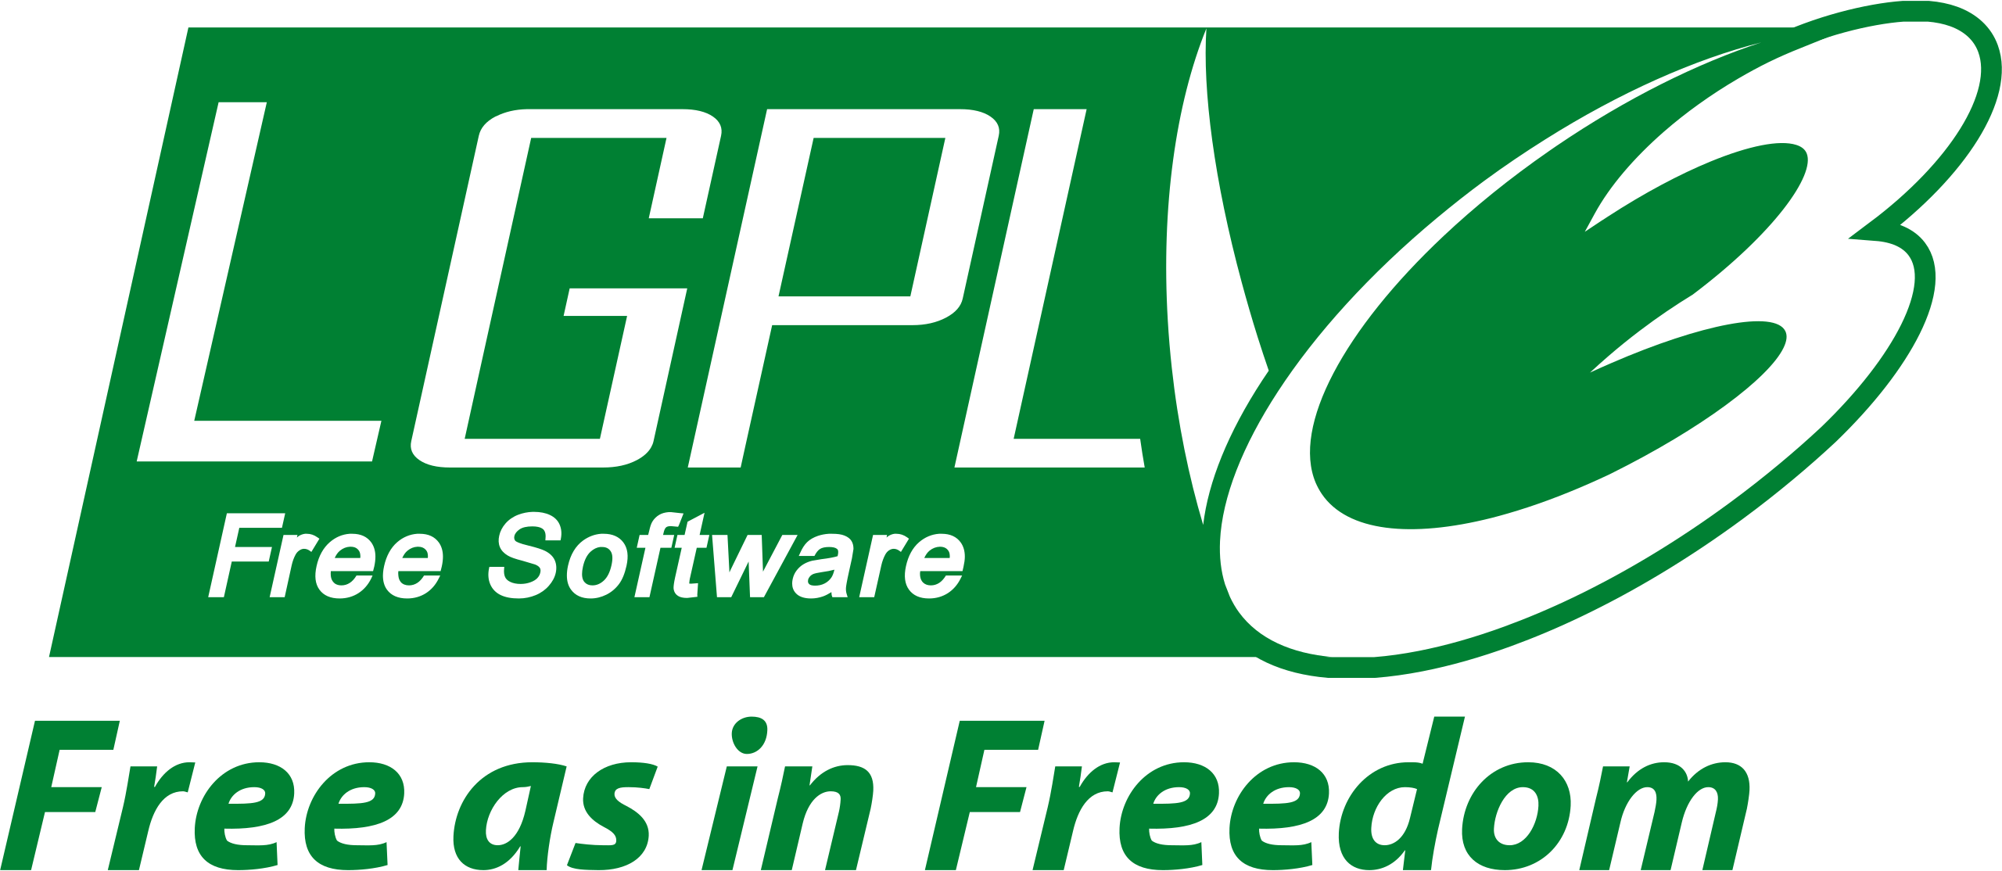
Yet another optimal control problem parser
IPOPT
Matlab
.m only
The only dependency
yop

Slide 3
Background
Target audience: practicing engineers and researchers
Matlab
Overcome competence/cost hurdle for the practicing engineer.
Competence in numerical optimal control, and numerical integration
Cost of obtaining licenses (e.g. PROPT) or cost of acquiring knowledge, if the benefit is uncertain
Provides structure to researchers and a validated basis
Design goal is to fit into the natural workflow of the practicing engineer:
Modeling, simulation, optimization
An abstraction to formulate and solve industrially relevant optimization problems.

Slide 4
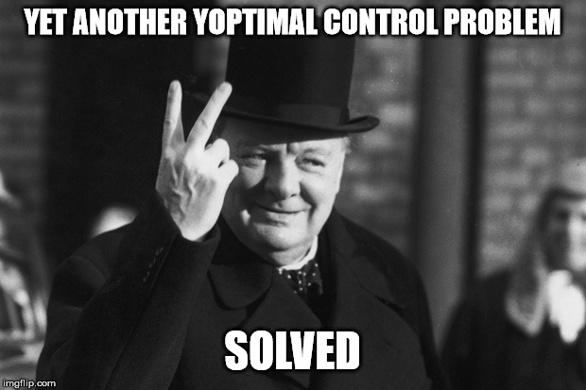
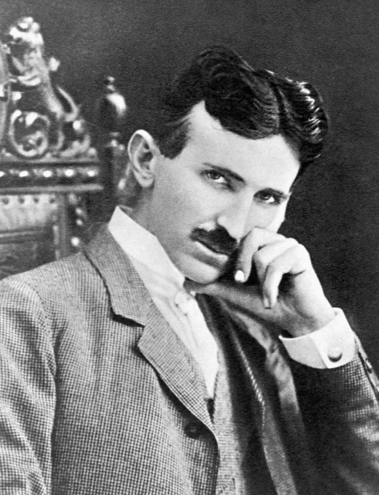
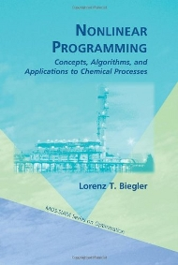
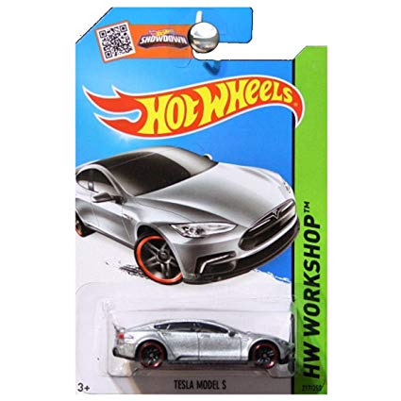
Workflow
Engineer
What is the best performance of my machine?
Application
Initial guess
yes
Optimal control problem
OK?
Discretization
NLP
solution
Question
Model
no

Slide 5
YopSystem
The model class
www.yoptimalcontrol.se//yopSystem

Slide 6
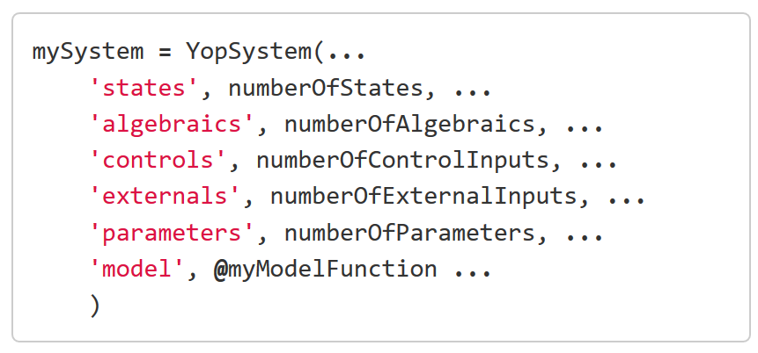
YopSystem – Semi explicit index-1 DAEs
algebraic variable
External input/exogenous variable
Independent variable
syntax
$$\dot{x}=f\left(t,x,z,u,w,p\right)$$
$0=g(t,x,z,u,w,p)$
parameter
state
control signal
/yopSystem

Slide 7
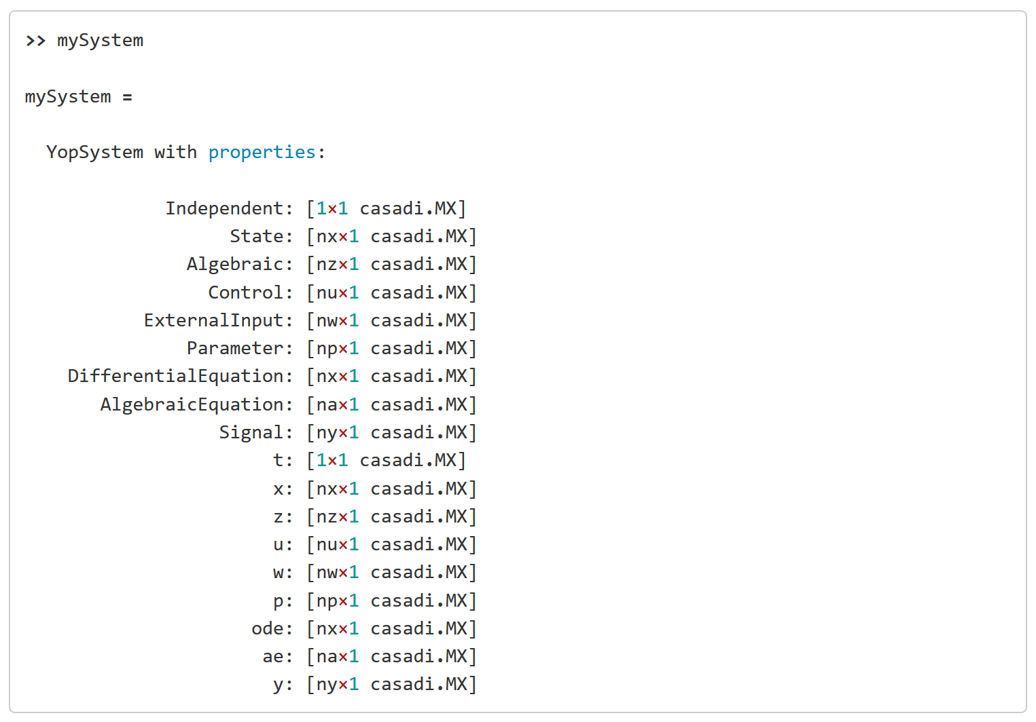
YopSystem - Properties
Output
Customizable
/yopSystem

Slide 8
Providing a model file
Syntax
Remove unnecessary
syntax
Always include first
/yopSystem#the-model-entry

Slide 9
If the file does not match the argument pattern
Syntax 1 – reorder arguments using an anonymous function
/yopSystem#when-the-model-file-do-not-match-the-argument-order

Slide 10
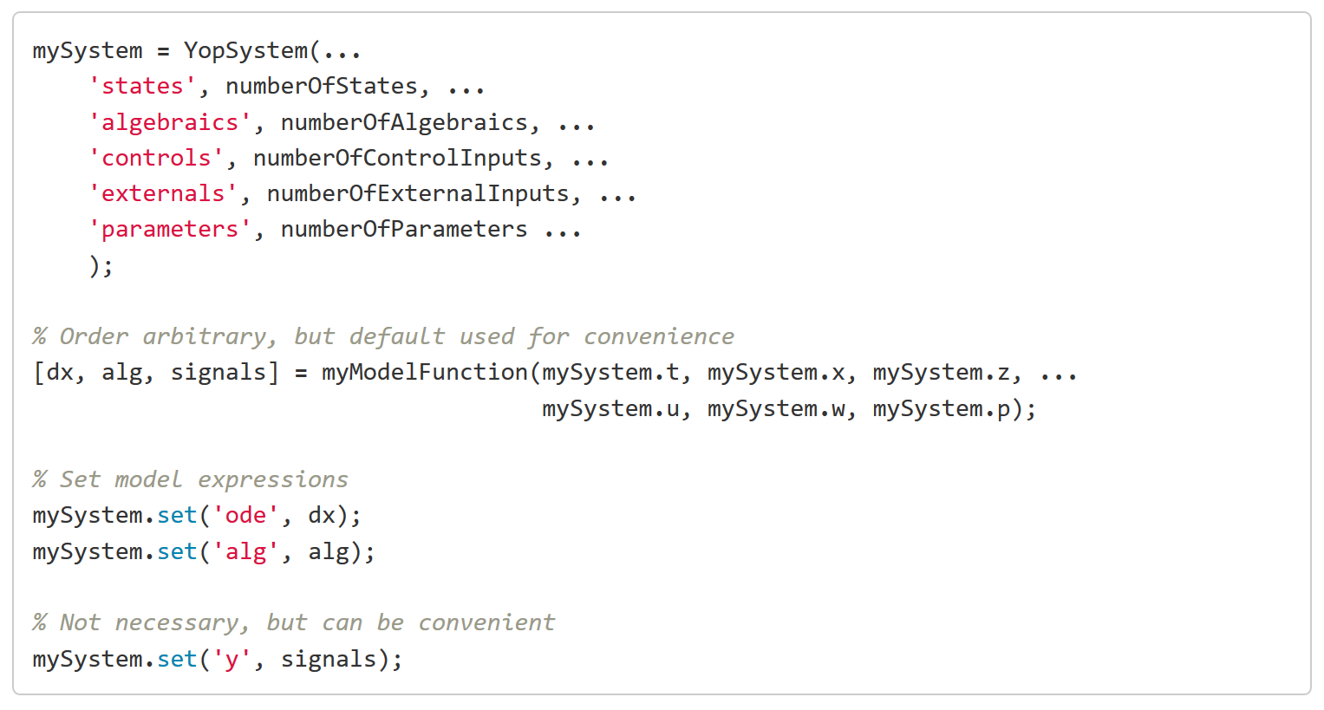
If the file does not match the argument pattern
Syntax 2 – set model equations manually
/yopSystem#when-the-model-file-do-not-match-the-argument-order

Slide 11
The independent variable
The independent variable is shared among all variables.
syntax
/independent

Slide 12
Connecting models - YopSystem
An algebraic constraint
syntax
syntax – equivalent formulations
/connections

Slide 13
Maps, look-up tables
It is possible to use 1-D linear and spline interpolation (YopInterpolant)
Available via CasADi interpolant

Slide 14
Simulation in Yop
/yopSimulator

Slide 15
Simulatable systems
$$\dot{x}=f\left(t,x,z,p\right)$$
$0=g(t,x,z,p)$
syntax
/yopSimulator#supported-systems

Slide 16
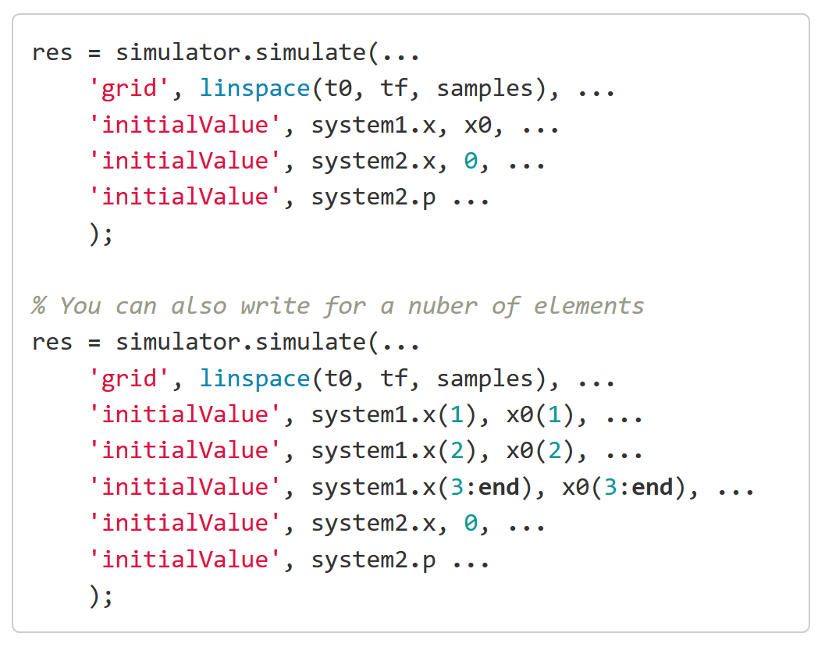
Running a simulation
syntax
/yopSimulator#simulating

Slide 17
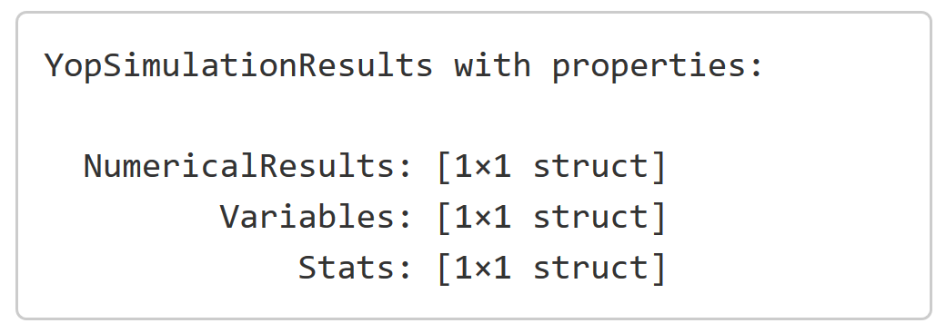
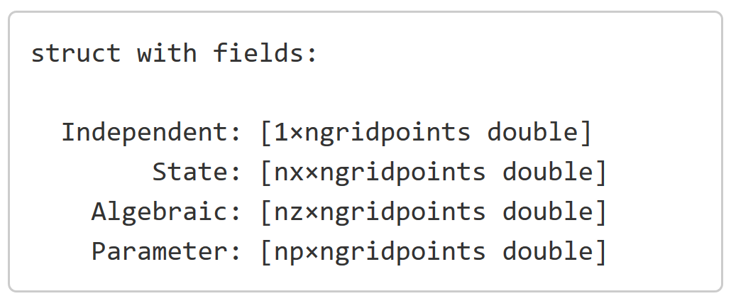
Numerical results
Output
/yopSimulator#obtaining-the-results

Slide 18
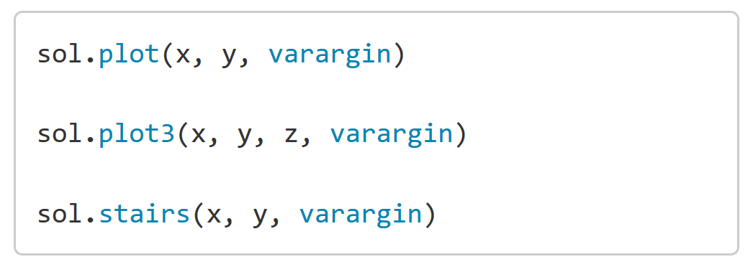
Symbolic signals and plotting
Syntax
/yopSimulator#obtaining-the-results

Slide 19
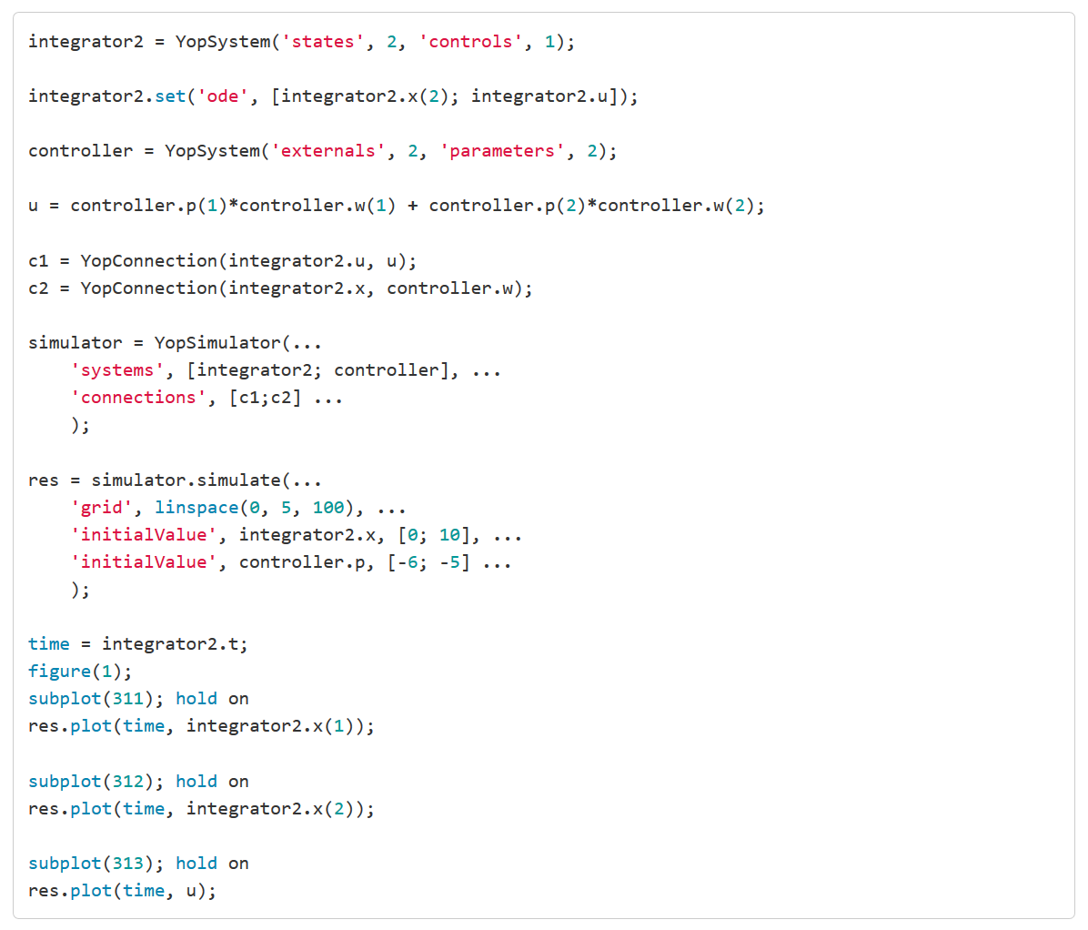
Simulation example: Control of double-integrator
/yopSimulator#obtaining-the-results

Slide 20
Optimal control
/formulatingOptimalControlProblems

Slide 21
Supported systems
$$\dot{x}=f\left(t,x,u,p\right)$$
Syntax – take 0 arguments
/formulatingOptimalControlProblems#declaring-optimal-control-problems

Slide 22
Specifying timepoints
2 natural timepoints for free end time OCPs
Syntax
/formulatingOptimalControlProblems#two-key-functions-t_f-and-t_0

Slide 23
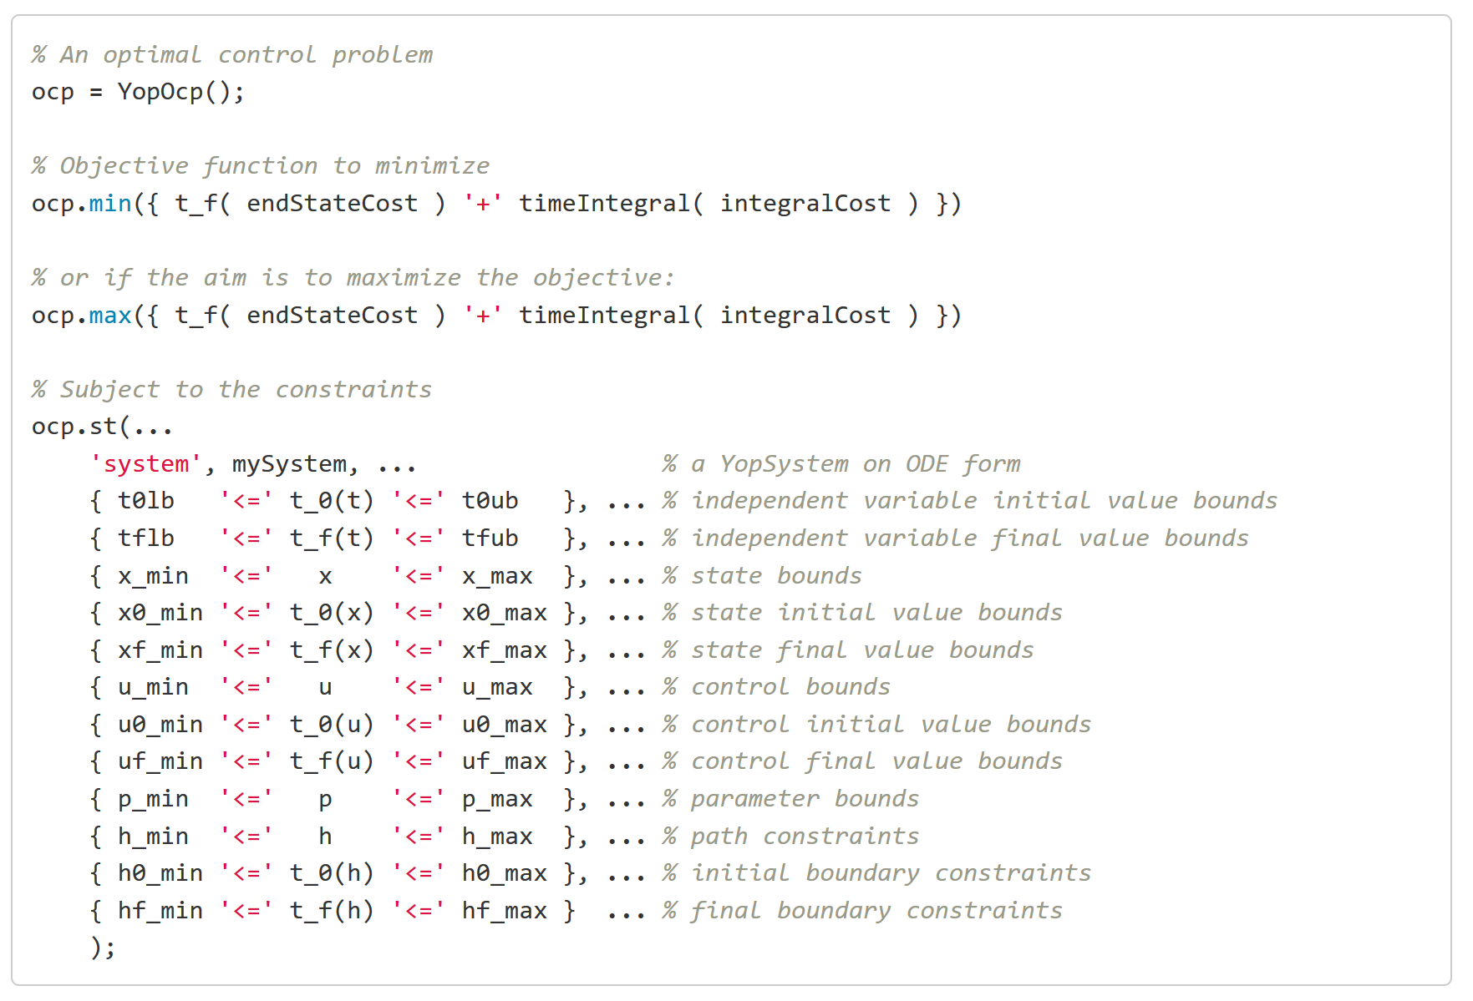
Objective and constraints
Always include first
/formulatingOptimalControlProblems#declaring-optimal-control-problems

Slide 24
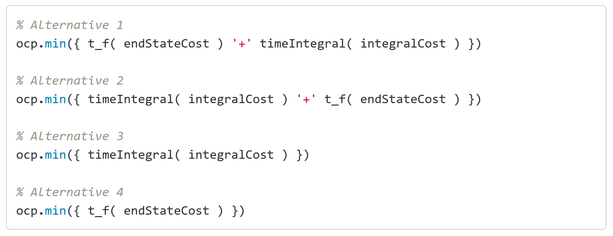
Objective
Syntax
/formulatingOptimalControlProblems#declaring-the-objective-function

Slide 25
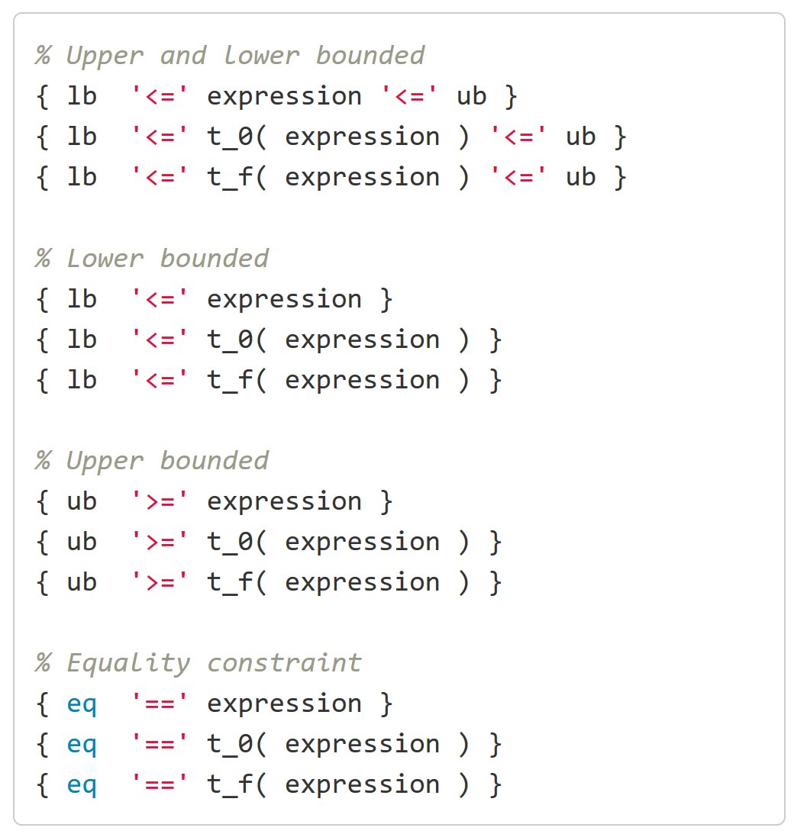
Constraints
Syntax
Easily extended to more variations
/formulatingOptimalControlProblems#declaring-constraints-using-st

Slide 26
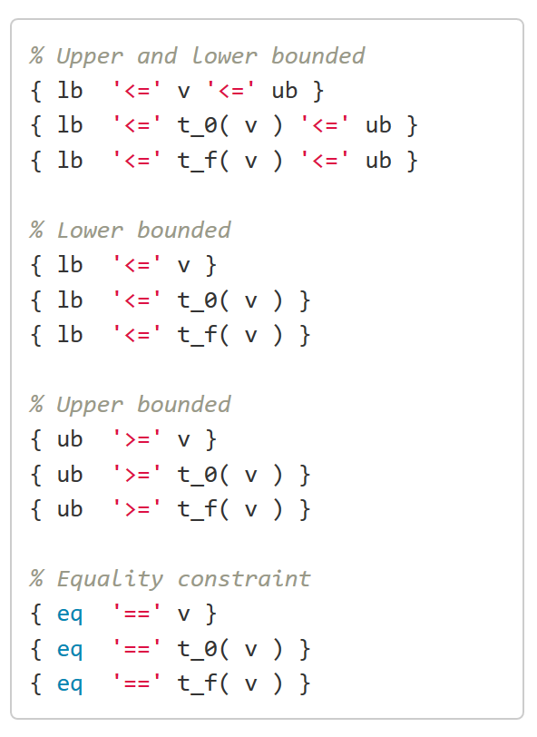
Box constraints – bounds on variables
Syntax same as any constraint
Automatically detected
$$\underline{x}≤x\left(t\right)≤\overline{x}$$
/formulatingOptimalControlProblems#box-constraints

Slide 27
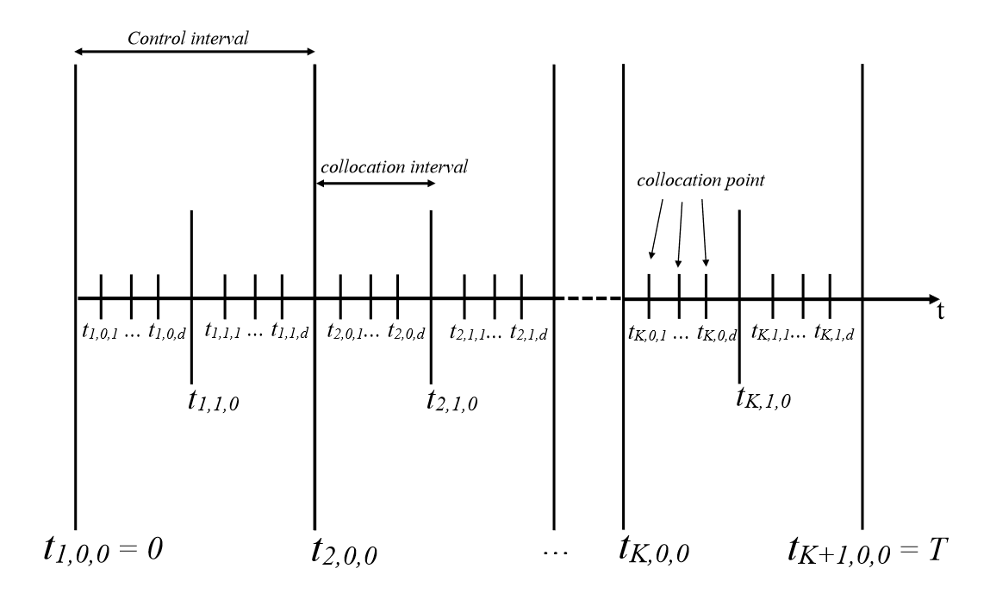
strict() path constraint
Normal path constraint
strict path constraint
/formulatingOptimalControlProblems#strict-path-constraints

Slide 28
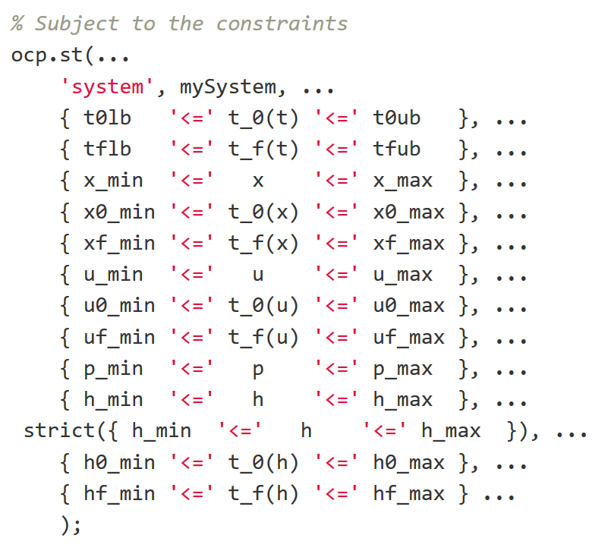
Why not always strict?
Syntax
To avoid creating NLPs with too few degrees of freedom.
Instead we select the constraints we want to be strict.
/formulatingOptimalControlProblems#strict-path-constraints

Slide 29
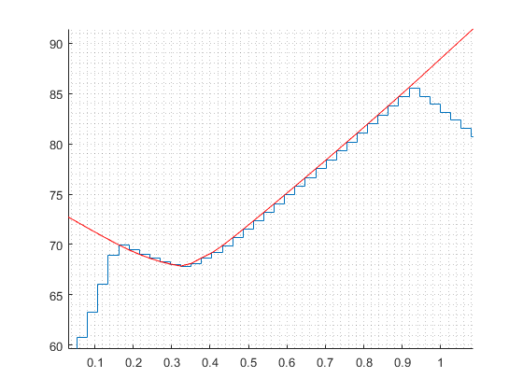
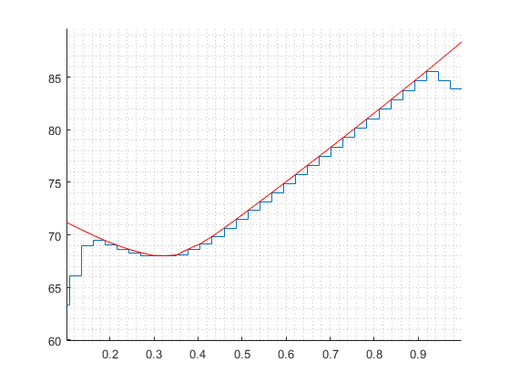
A strict example
Normal path constraint
strict path constraint
/transientOptimization

Slide 30
Scaling
/formulatingOptimalControlProblems#scaling

Slide 31
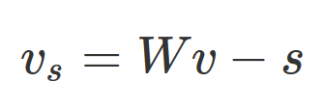
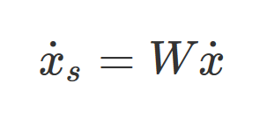
Scaling
Syntax
Variables:
Dynamics:
Objective:
Constraints (scaled by the user):
/formulatingOptimalControlProblems#scaling

Slide 32
Finding an initial guess
/initialGuess

Slide 33
Finding an initial guess
4 ways:
Not entering a guess at all. This sets the guess to 1.
Simulation
Solution to another OCP
Using YopInitialGuess
/initialGuess

Slide 34
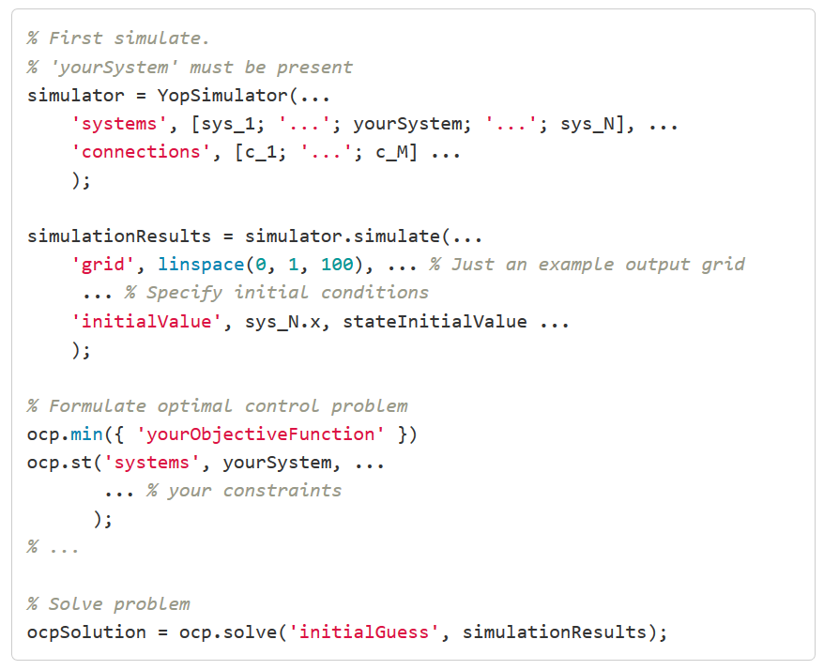
Using simulation
/initialGuess#using-simulation

Slide 35
Using a solution to another optimization problem
Syntax
/initialGuess#using-a-solution-to-another-optimal-control-problem

Slide 36
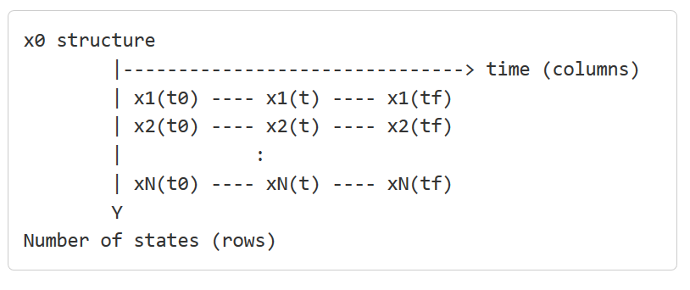
Using YopInitialGuess
Notice
Syntax
/initialGuess#using-yopinitialguess

Slide 37
Solving OCPs

Slide 38
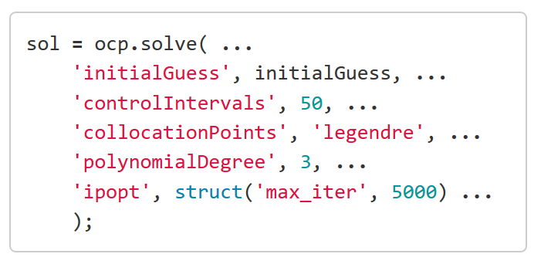
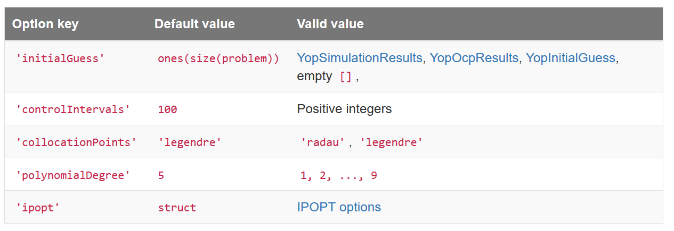
Solving OCPs
Syntax
Options
/solvingOcps#running-solve

Slide 39
build, parameterize, optimize
Speed-up when solving the same formulation with different parametrizations
Symbolic structure costly to create. Avoid rebuilding it by running:
build
(change parameter values)
parameterize
optimize
Loop
/solvingOcps#build-parameterize-optimize

Slide 40
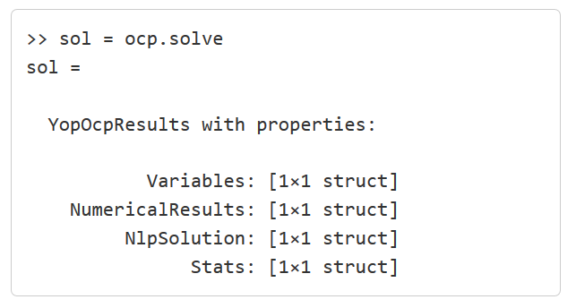
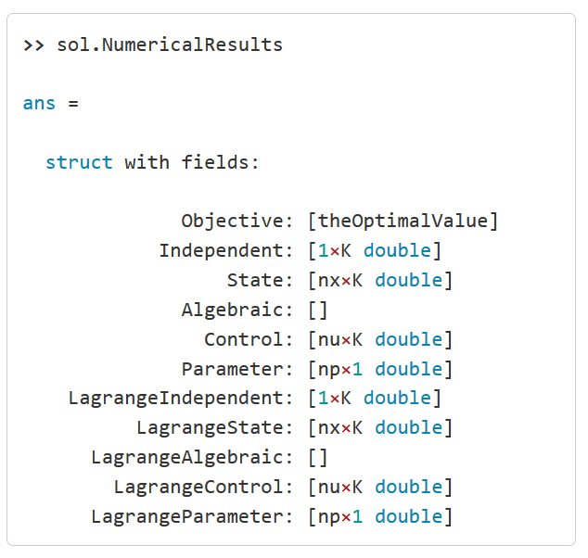
Obtaining the results
Output
Result behavs in the same way as simulation results
Syntax

Slide 41
Pareto optimal solutions

Slide 42
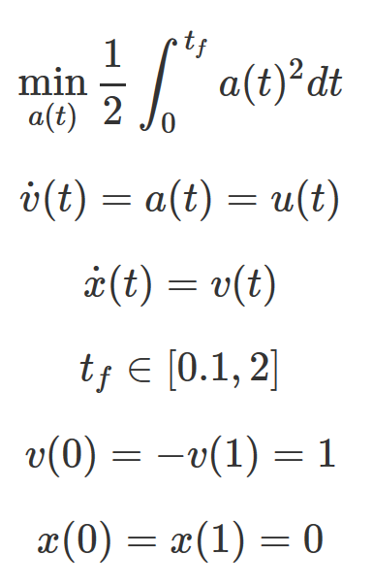
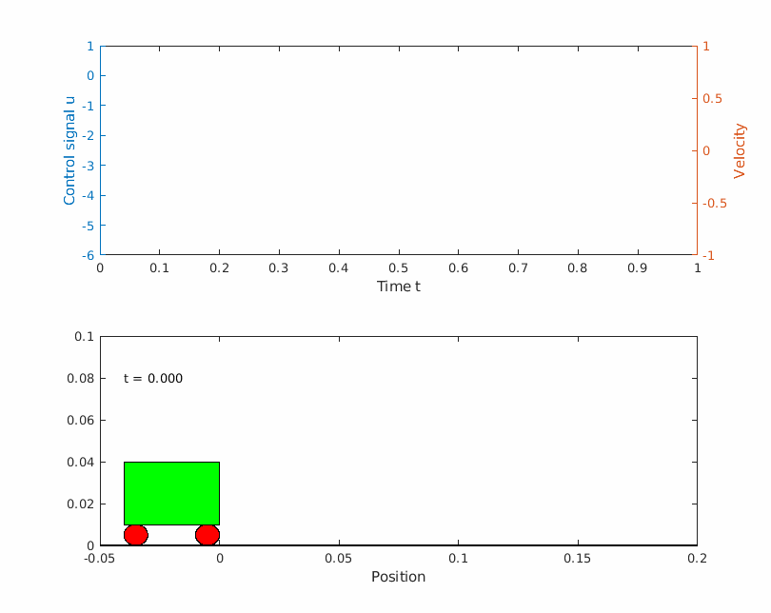
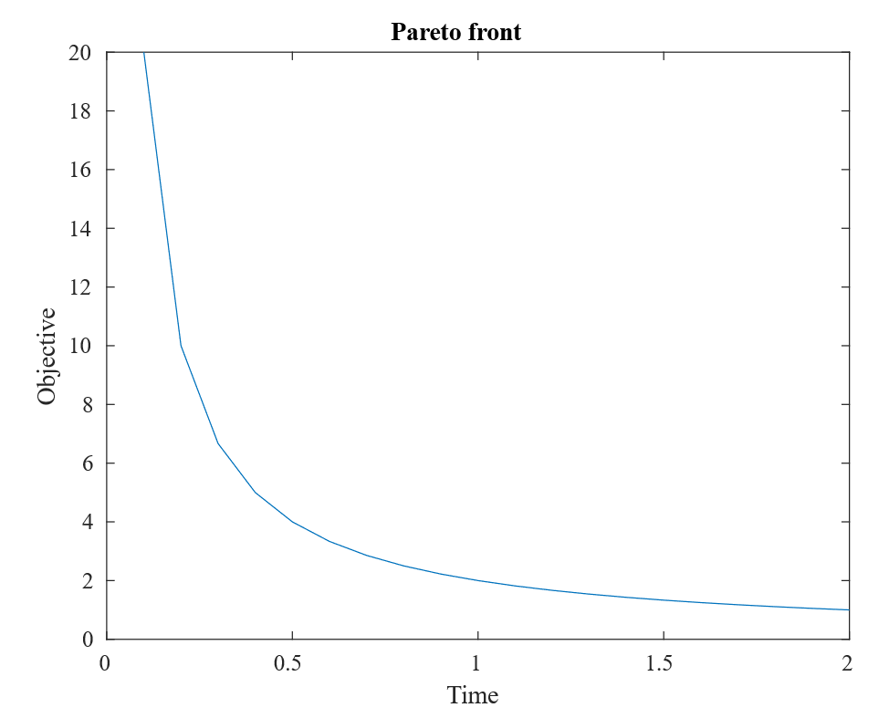
Pareto optimal solutions
https://www.yoptimalcontrol.se//brysonPareto

Slide 43
Planned features
MPC, Simulink, Parameter estimation, Set-point optimization

Slide 44
Topics not mentioned
Control signal parametrization
Non-differentiable equations
Saturations
Switching
Integral constraints
Derivative constraints
When integral and derivative constraints fail

Slide 45
Yoptimization completed
www.yoptimalcontrol.se emobilitycentre.se
viktor.leek@liu.se

Slide 46
Exercise: provide an initial guess for Goddard rocket
https://www.yoptimalcontrol.se/goddardLanding

